Slide 1


Title: EDA Web Scrapping on “Used cars analysis on Area wise and all over India"
By:
CH BHAVANI CHARY
D AKSHAY KUMAR REDDY
B UMESH CHANDRA

Slide 2
ABOUT US:
CH BHAVANI CHARY
MBA Graduate / Data Analytics and Visualization.
LinkedIn : http://www.linkedin.com/in/bhavani-chary-chityala/
GitHub : https://github.com/chityala-bhavani-chary
D AKSHAY KUMAR REDDY
MCA Graduate / Data Analytics and Visualization.
LinkedIn : https://www.linkedin.com/in/akshay-kumar-reddy-725443230 GitHub : https://github.com/akshay1023
B UMESH CHANDRA
B.Tech Graduate / Data Analytics and Visualization.
LinkedIn : http://www.linkedin.com/in/umesh-chandra-bathula
GitHub : https://github.com/Umeshchandra2119

Slide 3
Agenda :
Conclusion (Key finding overall)
Your Experience/Challenges working on Web Scraping – Data Analysis Project.
Exploratory Data Analysis:
Data Cleaning Steps
Data Manipulation Steps
Univariate Analysis Steps
Bivariate Analysis Steps
Multi Variate Analysis steps
Introduction
Business Problem
Objective of the Project
Tools used
Web Scraping – Details (Websites, Processor followed by us)
Summary of the Data

Slide 4
# Introduction

Slide 5
Introduction :
The Indian used car market is expanding rapidly due to rising vehicle costs, urban mobility needs, and digital resale platforms.
Cars24 operates as a large-scale online marketplace enabling transparent buying and selling of used vehicles across India.
Used car pricing is influenced by multiple factors including fuel type, vehicle age, mileage, and regional demand.
Understanding these factors is essential for accurate pricing, better inventory planning, and informed decision-making.
Raw marketplace data often contains variability, outliers, and hidden patterns that require systematic analysis.
Exploratory Data Analysis (EDA) helps uncover relationships, trends, and distributions within used car data.
This project applies EDA techniques on Cars24 data to extract insights into resale value drivers and market behavior.

Slide 6
Business Problem :
Used car prices vary significantly due to multiple factors such as fuel type, vehicle age, mileage, and regional demand, making pricing complex and inconsistent.
Absence of clear, data-driven pricing insights can result in:
Over pricing leading to slower sales and inventory backlog, Under pricing causing revenue loss
Without proper analytical insights, platforms may face inefficient inventory allocation across regions and fuel types.
Regional and fuel-based demand variations are often overlooked, resulting in suboptimal market and pricing strategies.
The Cars24 dataset reflects a real-world used car marketplace, capturing diverse vehicle attributes and regional behavior.
Analyzing this data enables platforms like Cars24 to:
Understand regional demand patterns,
Identify high-value and high-liquidity vehicle segments,
Optimize pricing and inventory planning decisions

Slide 7
Objective :
To analyze area-wise and state-wise distribution of used car prices across India.
To identify regional variations in resale value and pricing behavior.
To study the impact of fuel type, kilometres travelled, and manufacturing year on used car prices.
To examine state-wise fuel preferences and their influence on resale pricing.
To compare high-demand and low-demand regions in the used car market.
To apply univariate, bivariate, and multivariate exploratory analysis techniques.
To generate data-driven insights supporting regional pricing, inventory, and market strategies.

Slide 8








Tools Used :

Slide 9
# Web Scraping

Slide 10
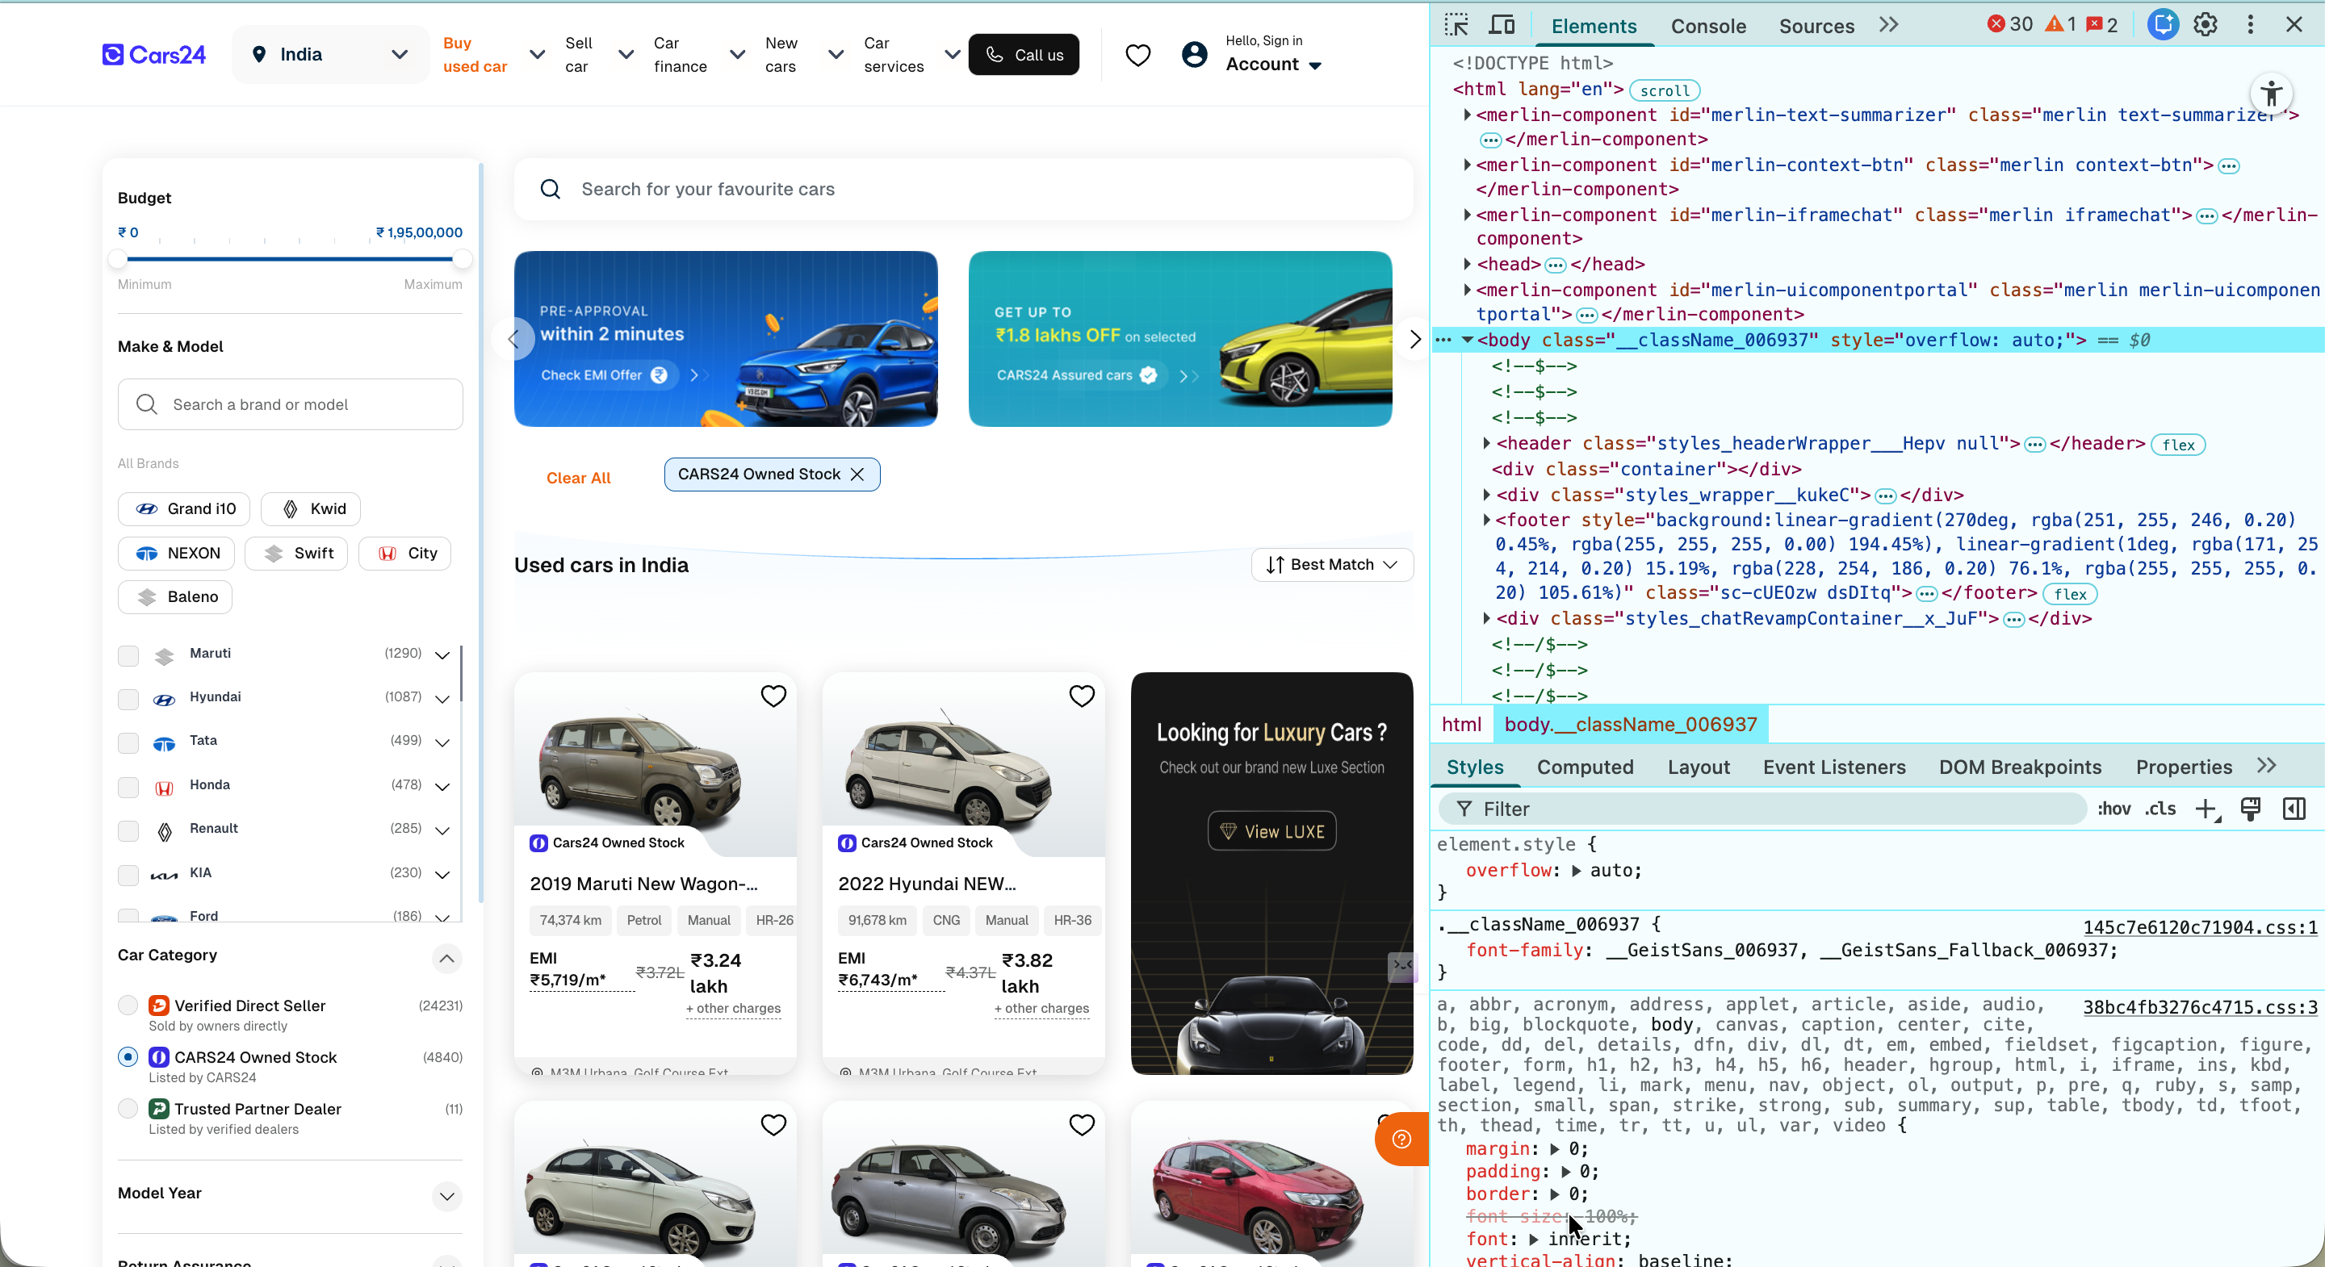
Web Scraping:
Web scraping is the process of automatically extracting structured data from websites for analysis and decision-making.
Online platforms like Cars24 generate large volumes of real-time market data that are not always available in downloadable formats.
Manual data collection from such platforms is time-consuming, error-prone, and inefficient.
Web scraping enables analysts to collect large datasets quickly and consistently from online marketplaces.
Scraped data can include key attributes such as price, fuel type, location, mileage, and manufacturing year.
This collected data forms the foundation for exploratory data analysis (EDA) and statistical evaluation.
In this project, web-scraped data supports area-wise and India-wide analysis of used car pricing trends.

Slide 11
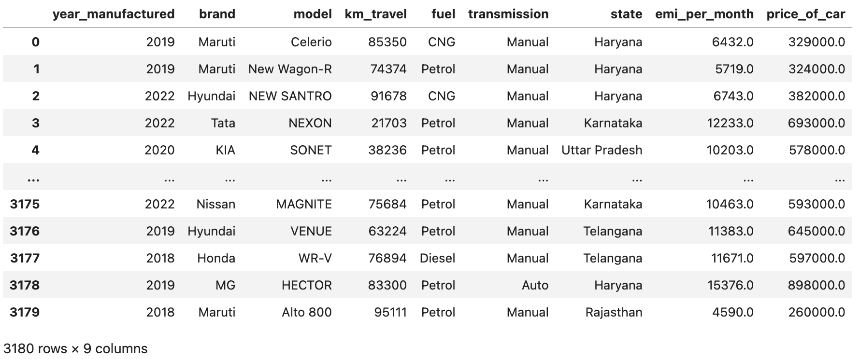
Dataset:
<class 'pandas.DataFrame'>
RangeIndex: 3180 entries, 0 to 3179
Data columns (total 9 columns):
# Column Non-Null Count Dtype
--- ------ -------------- -----
0 year_manufactured 3180 non-null str
1 brand 3180 non-null str
2 model 3180 non-null str
3 km_travel 3180 non-null int64
4 fuel 3180 non-null str
5 transmission 3180 non-null str
6 state 3180 non-null str
7 emi_per_month 3180 non-null float64
8 price_of_car 3180 non-null float64
dtypes: int64(4), str(5)
memory usage: 325.3 KB

Slide 12
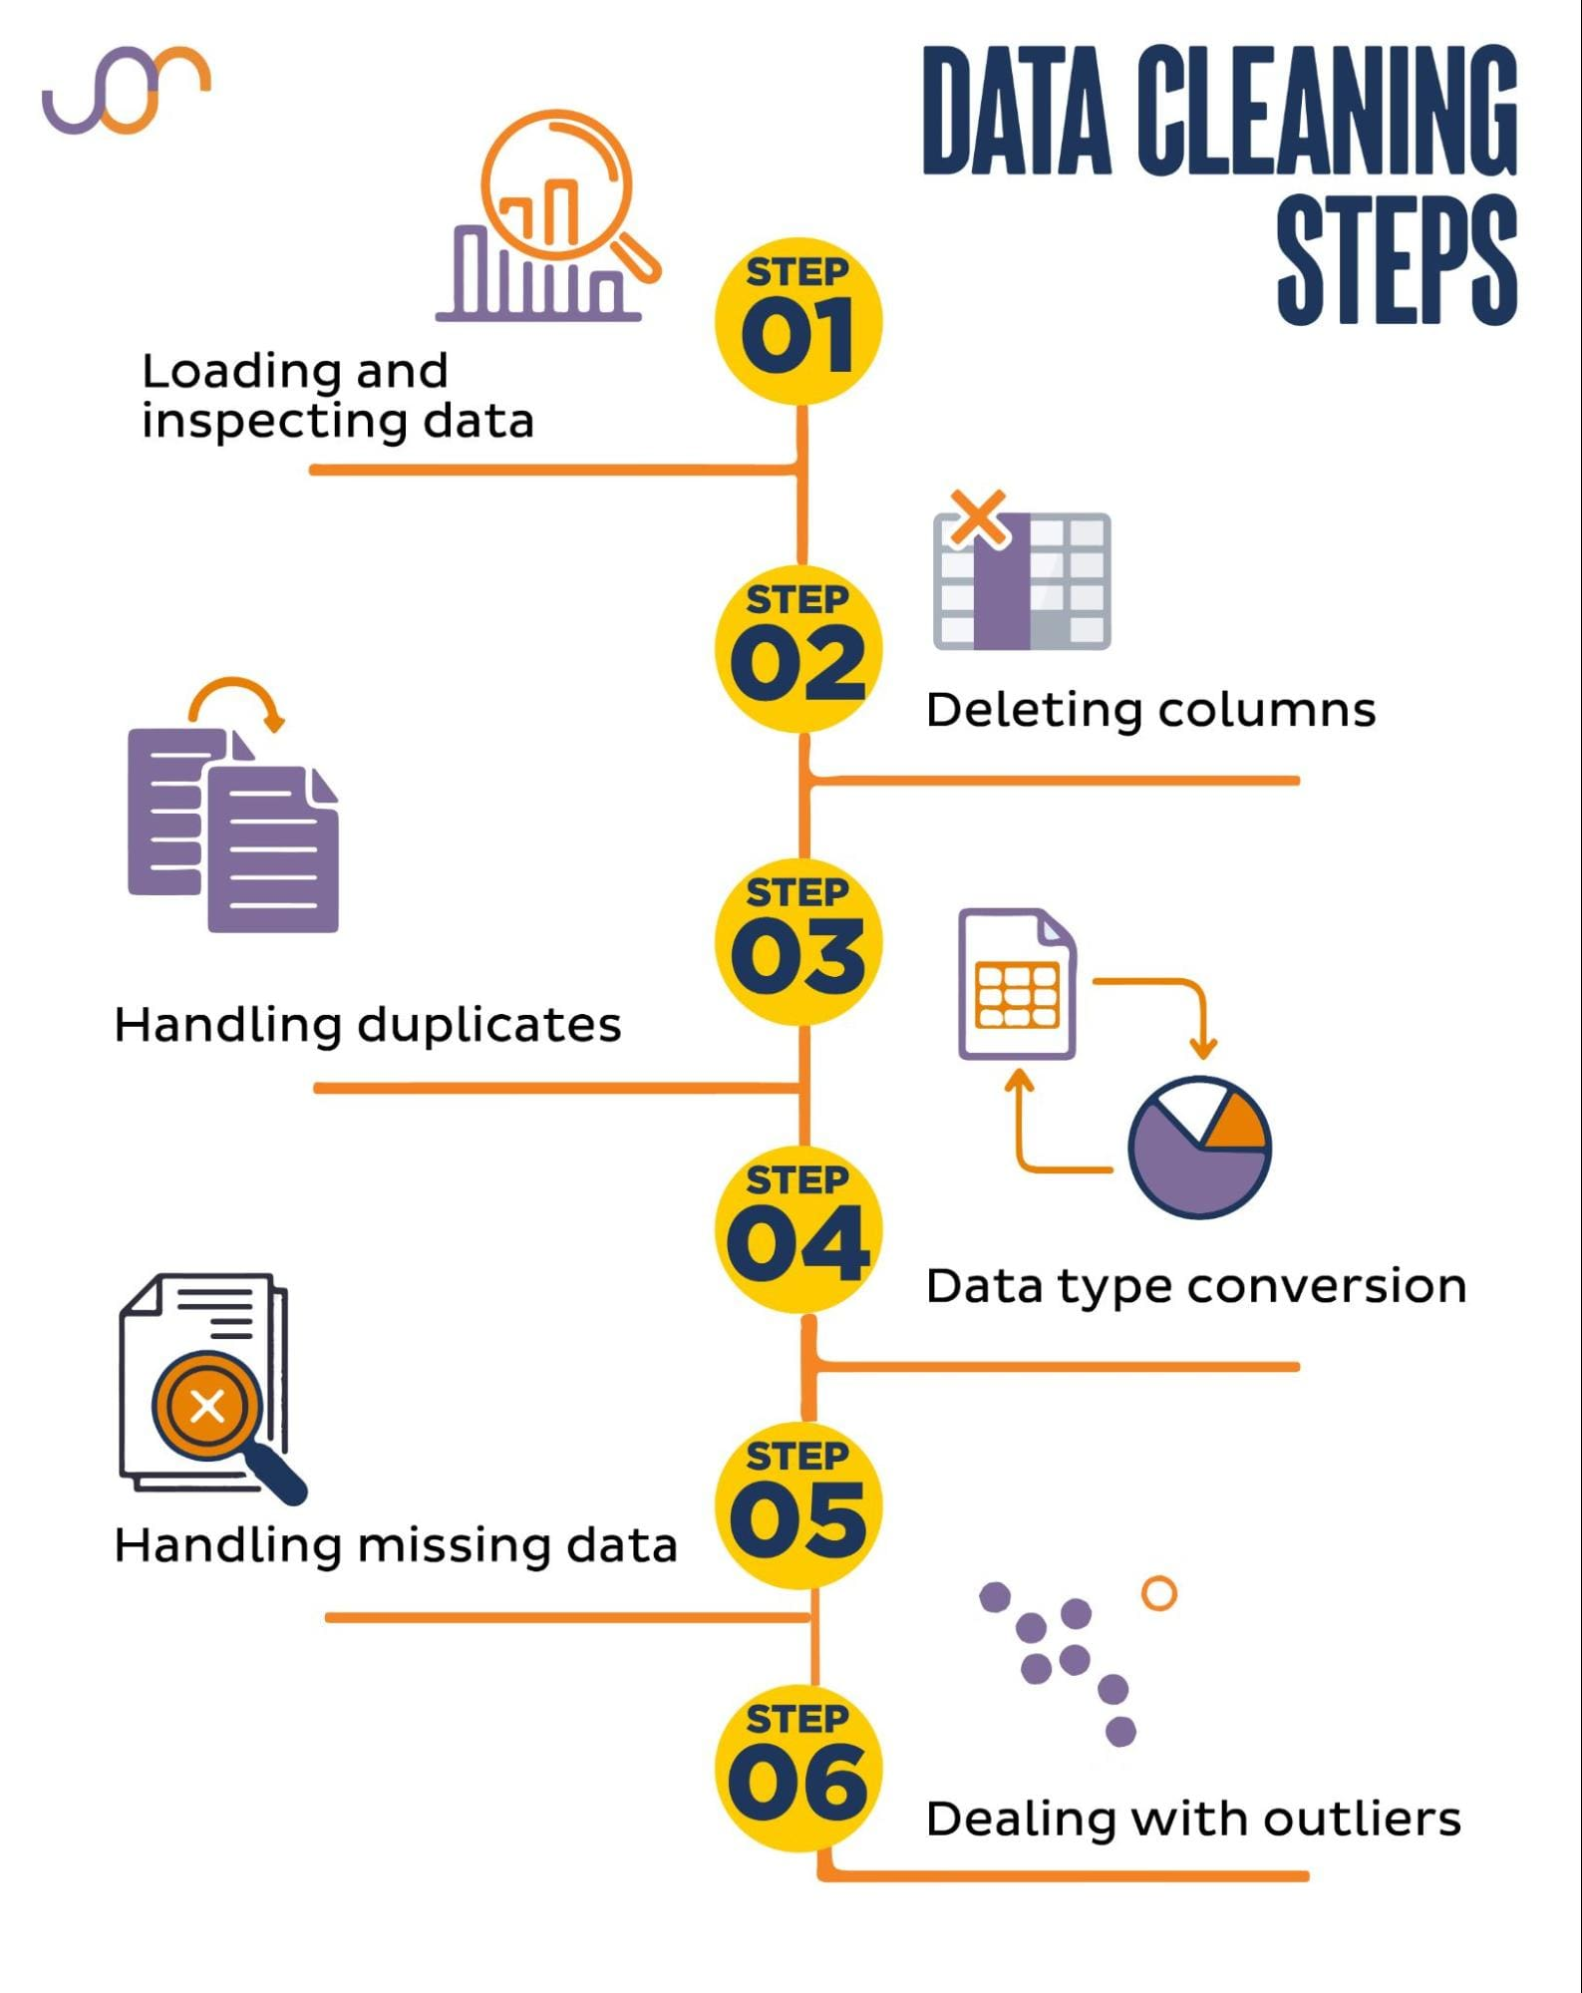

Data Cleaning Steps:
Loading and Inspecting Data
Loaded the Cars24 dataset and examined its structure, column names, data types, and basic statistics to understand the data quality.
Deleting Irrelevant Columns
Removed unnecessary or non-informative columns that did not contribute to price analysis or regional insights.
Handling Duplicate Records
Checked for duplicate car listings and ensured that duplicate entries did not affect the analysis results.
Data Type Conversion
Converted columns such as price, kilometres travelled, EMI, and year of manufacture into appropriate numerical formats for accurate analysis.
Handling Missing Data
Identified missing values and handled them appropriately to avoid distortion in statistical calculations and visualizations.
Dealing with Outliers
Detected extreme price values and high-mileage vehicles; used median-based interpretation and visual analysis to minimize outlier impact.

Slide 13
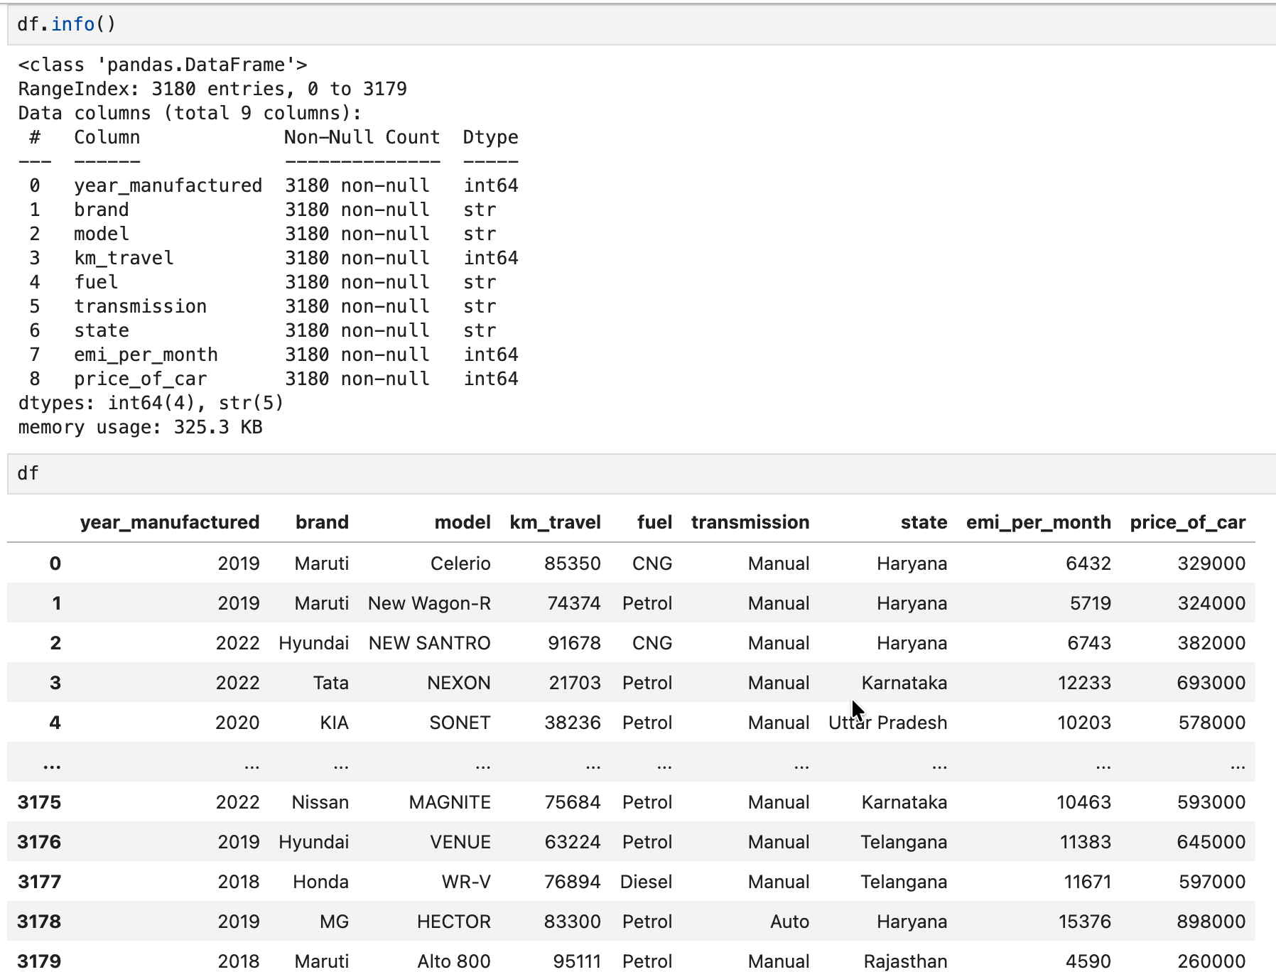
Cleaned Dataset & checking data structure:

Slide 14
# Data Analysis

Slide 15
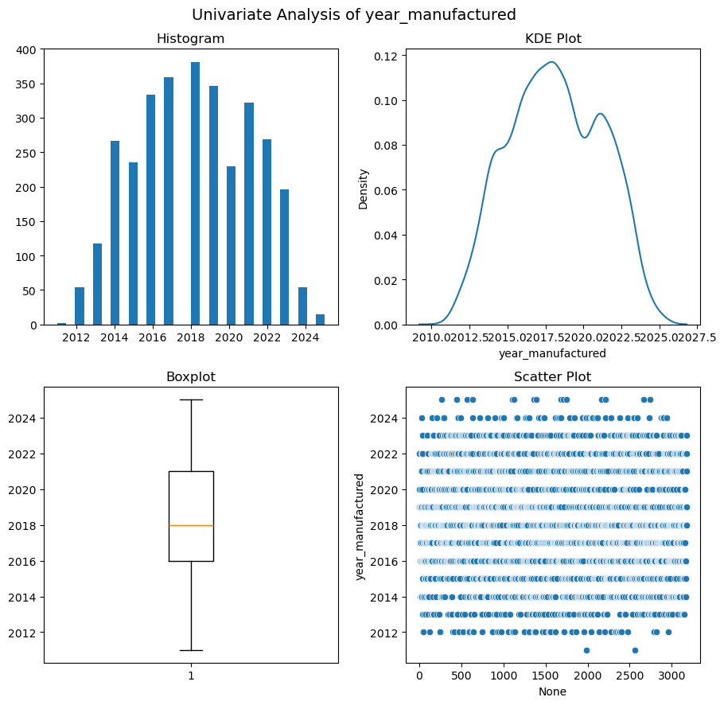
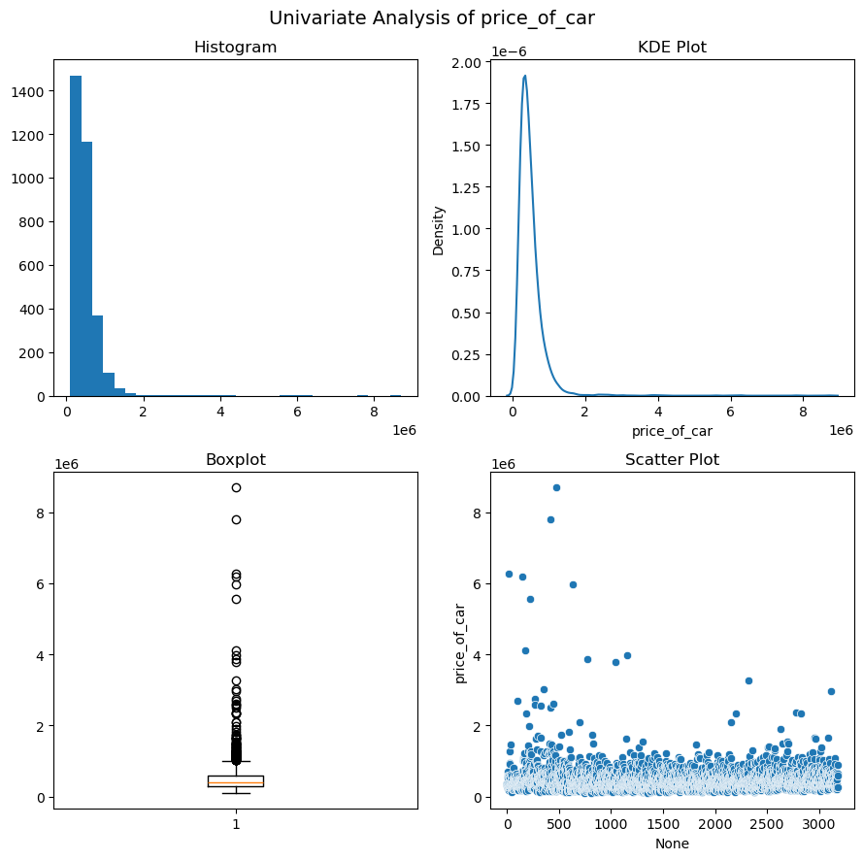
1. UNIVARIATE ANALYSIS:
Key Insights - (year_manufacture)
Used-car dominant inventory: Most cars are 4–10 years old, with the highest concentration around 6–8 years, indicating a mature and stable used-car market.
Well-balanced age distribution: Nearly symmetric distribution with very low skewness, showing no bias toward extremely new or very old vehicles.
Clean and reliable data: Age ranges from 0 to 14 years with no extreme outliers, reflecting controlled data quality.
Key Insights - (price_of_car)
Affordable segment dominates: Majority of cars are priced in the lower to mid-range, with most values below ₹10 lakh.
Presence of luxury vehicles: A long right tail and several high-end outliers (up to ₹80+ lakh) indicate a small luxury segment.
Highly skewed distribution: Very high skewness and kurtosis confirm prices are non-uniform and outlier-driven, not normally distributed.

Slide 16
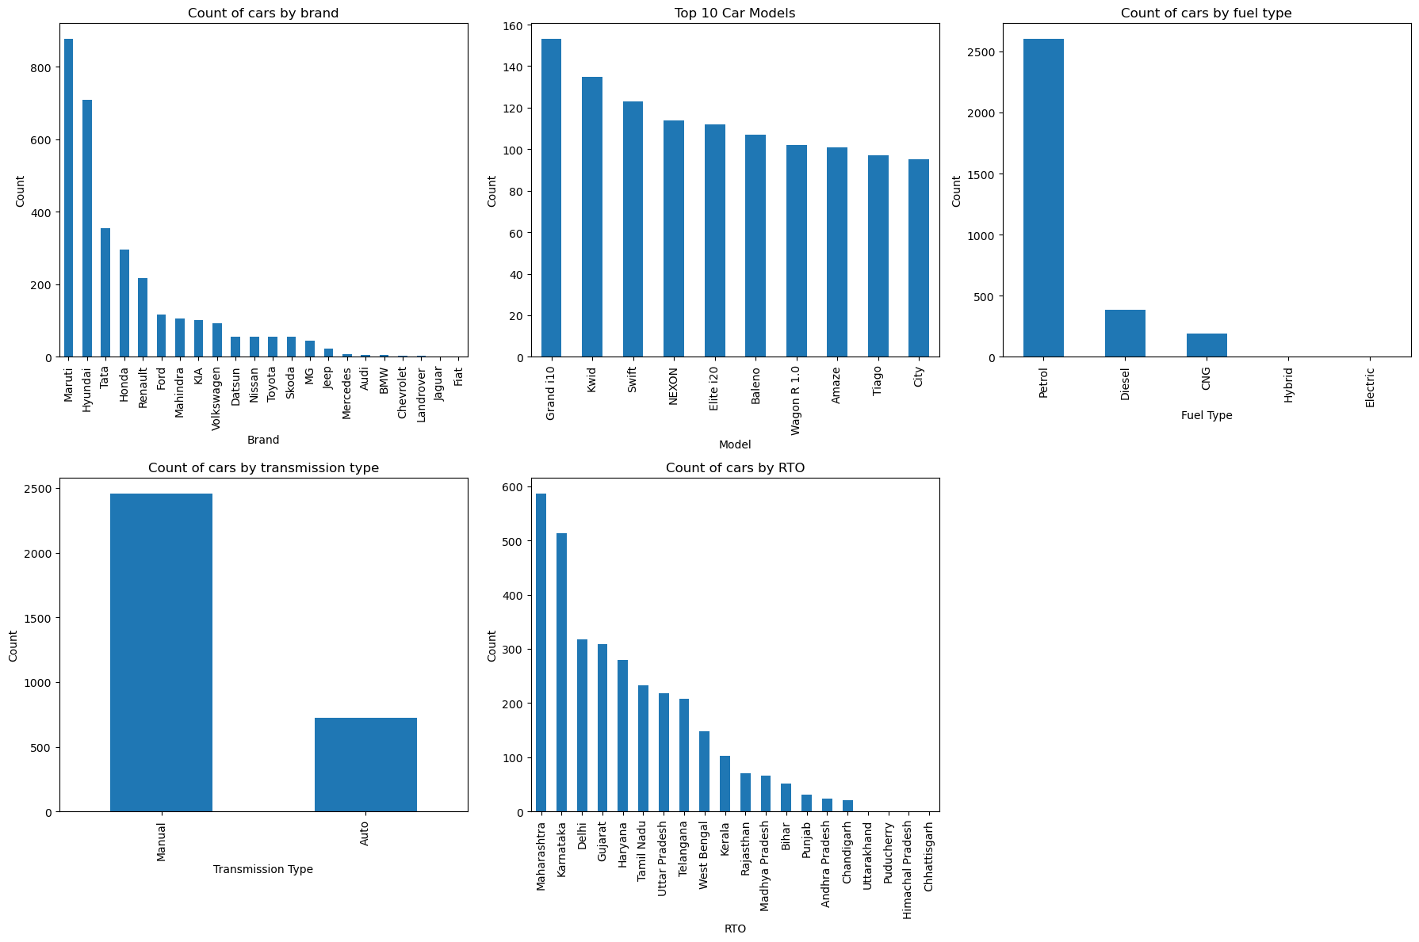
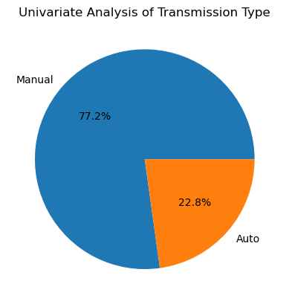
1. UNIVARIATE ANALYSIS:
Key Insights:
Maruti and Hyundai clearly dominate the dataset with the highest car counts.
No single car model overwhelmingly dominates among the top 10 models.
Petrol is the most common fuel type, with Diesel far behind and others negligible.
Manual transmission cars clearly dominate the dataset, accounting for about 77% of all vehicles, while automatic cars make up only around 23%.
Car registrations are concentrated in a few RTOs, especially Maharashtra and Karnataka.

Slide 17
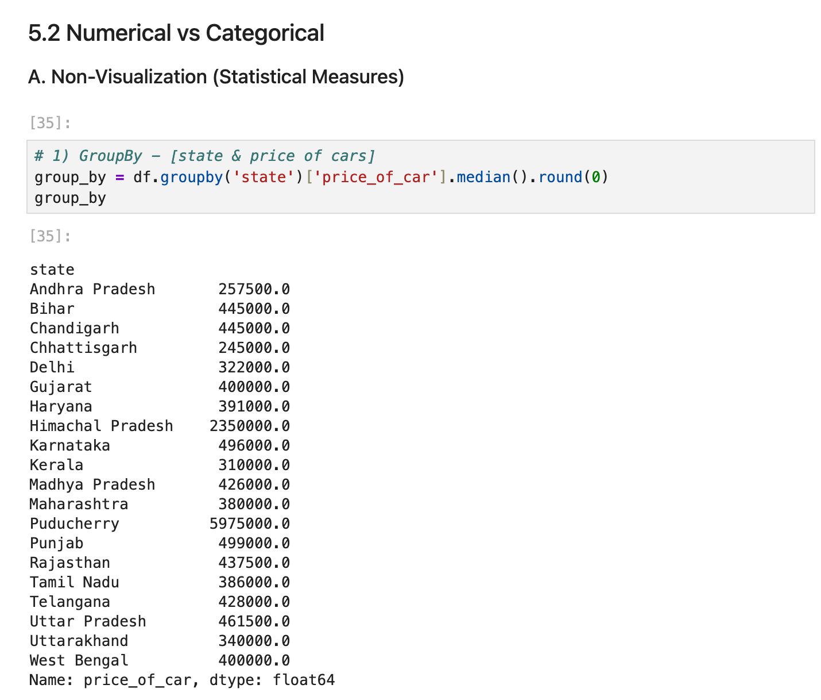
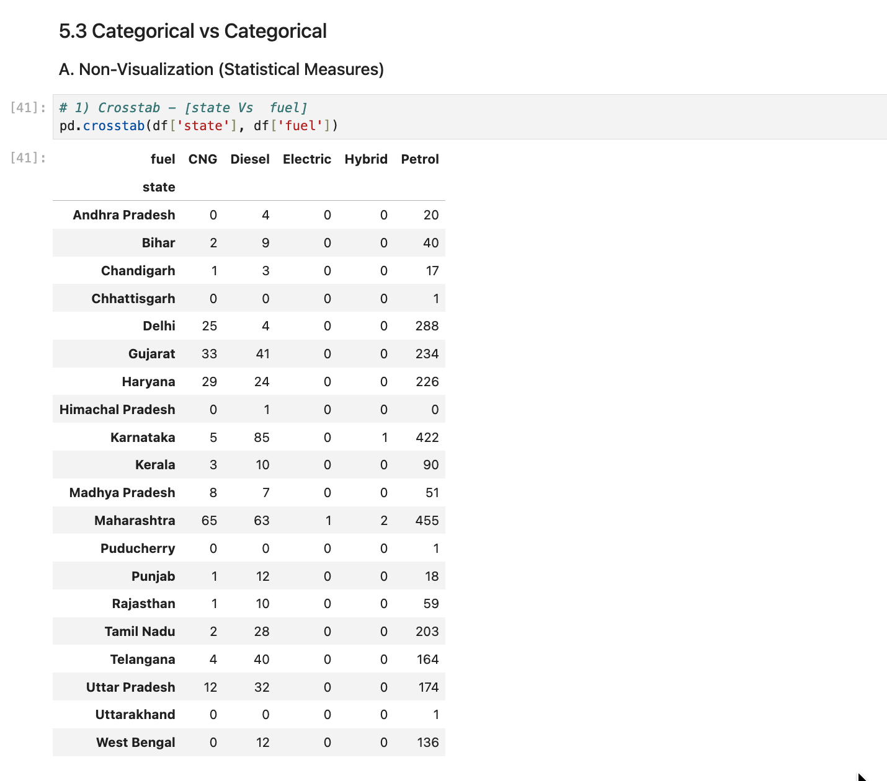
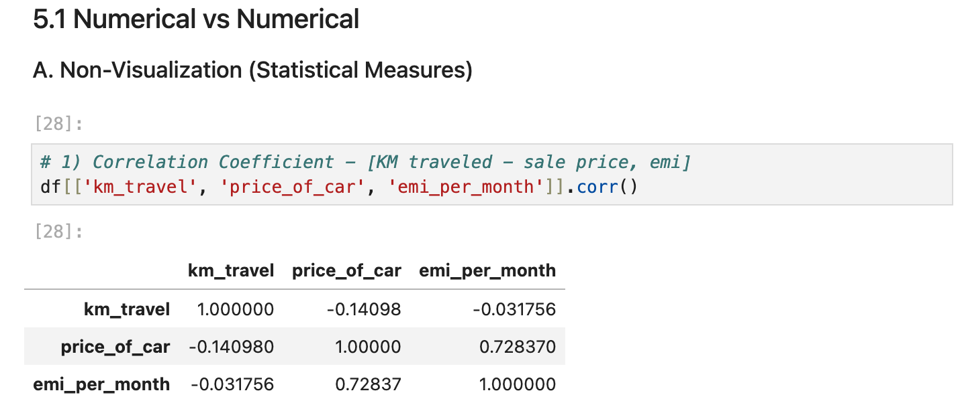
2. BIVARIATE ANALYSIS:

Slide 18
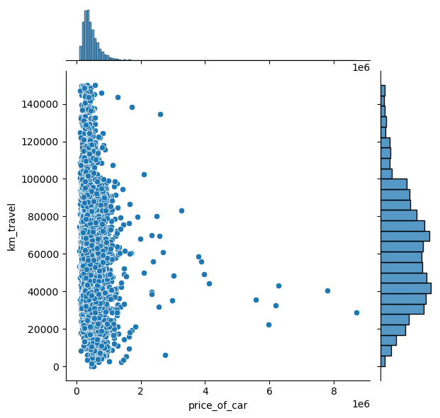
2. BIVARIATE ANALYSIS:
1) Num vs Num - Visualization
# Jointplot - [km_travel vs price_of_car]
Insights
Car price and kilometers travelled show a weak inverse relationship, confirming mileage-related depreciation.
High-priced vehicles are concentrated at lower mileage levels, indicating premium cars retain value when usage is limited.

Slide 19
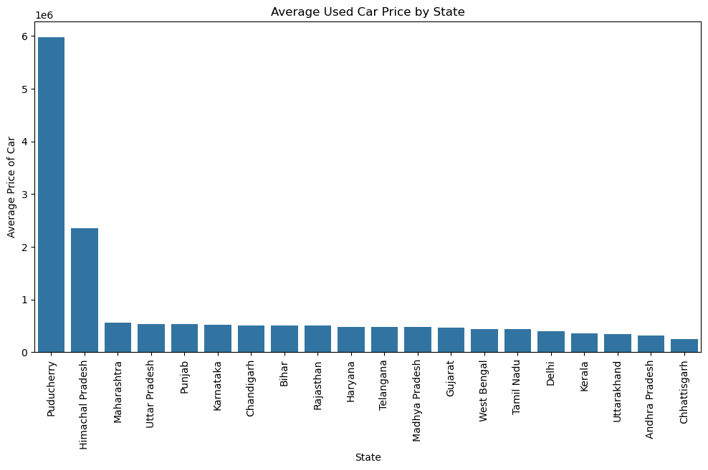
2. BIVARIATE ANALYSIS:
2) Num vs Cat - Visualization
# Bar Plot - [state vs average price_of_car ]
Insights
Average used car prices vary substantially across states, indicating strong regional differences in resale market dynamics.
States with higher average prices (such as Maharashtra, Karnataka, Punjab, and Uttar Pradesh) likely reflect greater demand for newer or premium vehicles, higher income levels, and stronger urban presence.
States with lower average prices suggest a higher concentration of older or budget vehicles, possibly driven by lower purchasing power or rural dominance.
Extremely high average prices in certain states may be influenced by a small number of high-value listings, highlighting the impact of outliers on mean-based analysis.
Overall, the plot indicates that state-level factors play a crucial role in determining used car pricing, emphasizing the need for region-specific pricing and inventory strategies.

Slide 20
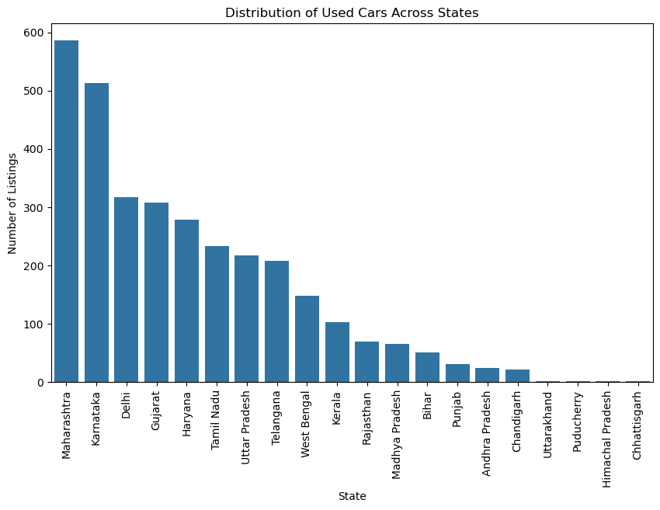
2. BIVARIATE ANALYSIS:
2) Cat vs Cat - Visualization
# Count Plot - [state vs count]
Insights
Used car listings are highly concentrated in a few states, indicating regional dominance in the resale market.
States with higher listing counts likely represent larger urban populations, stronger vehicle turnover, and higher digital marketplace adoption.
States with fewer listings may reflect lower market activity, limited platform penetration, or smaller population bases.
Overall, the distribution highlights significant regional imbalance in used car availability across the country.

Slide 21
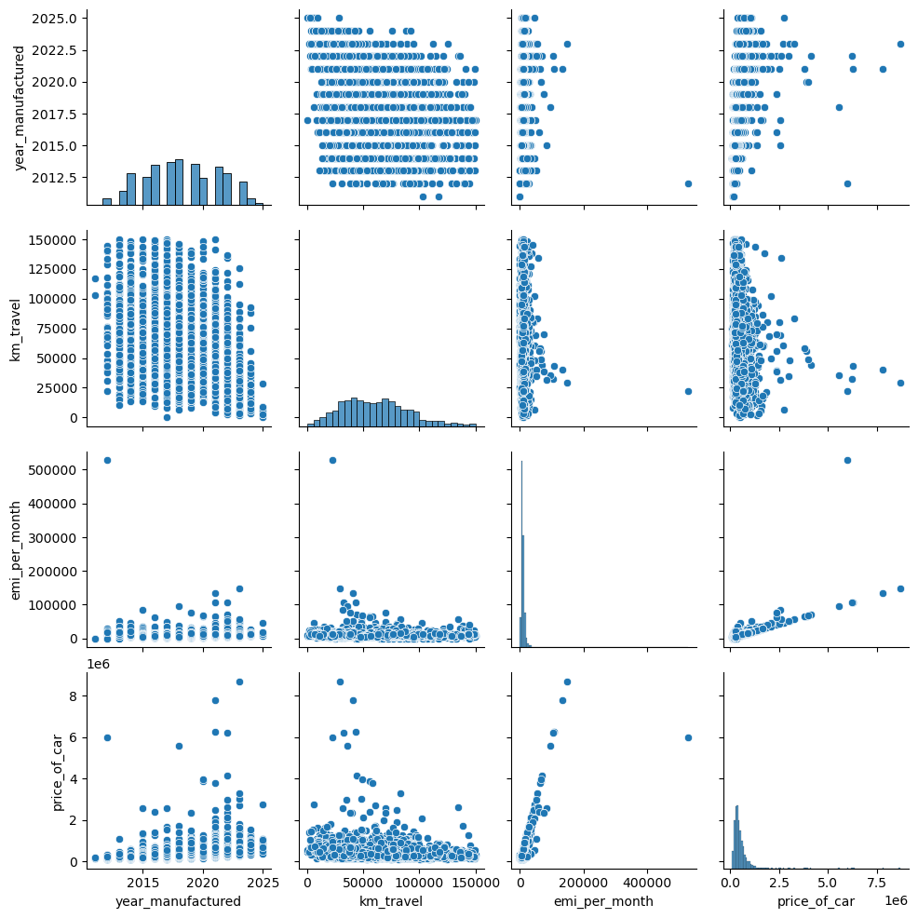
3. MULTIVARIATE ANALYSIS:
Unique Insights from Pair Plot Analysis:
Price vs EMI per Month: Car price increases sharply with EMI per month, showing a strong positive relationship.
Price vs Kilometers Travelled: Car price generally decreases as kilometers travelled increase, though the relationship is weak.
Price vs Year Manufactured: Newer manufactured cars tend to have higher prices, indicating a positive trend.
EMI vs Kilometers Travelled: EMI values are scattered across all kilometer ranges, showing no clear relationship.
EMI vs Year Manufactured: EMI shows a very weak upward trend with newer manufacturing years.
Kilometers Travelled vs Year Manufactured: Older manufactured cars tend to have higher kilometers travelled, showing a clear negative relationship.
Kilometers Travelled Distribution: Most cars fall within a mid-range of usage, with fewer extreme values.
Year Manufactured Distribution: The dataset is dominated by newer cars, indicating more recent manufacturing years.

Slide 22
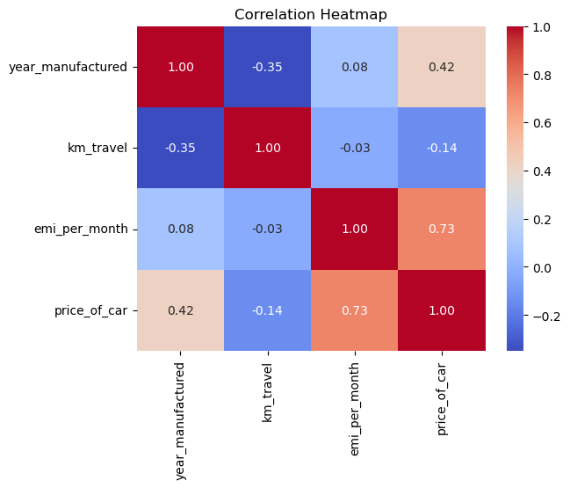
3. MULTIVARIATE ANALYSIS:
Unique Insights from Correlation Analysis:
Price vs EMI per Month: As car price increases, EMI per month also increases strongly, indicating a high positive relationship.
Price vs Kilometers Travelled: As kilometers travelled increase, car price slightly decreases, showing a weak negative relationship.
Price vs Year Manufactured: Newer manufacturing years are associated with higher car prices, indicating a moderate positive relationship.
EMI vs Kilometers Travelled: EMI has almost no relationship with kilometers travelled, meaning usage does not influence EMI values.
EMI vs Year Manufactured: Manufacturing year has a very weak influence on EMI, showing minimal impact.
Kilometers Travelled vs Year Manufactured: Older cars generally have higher kilometers travelled, indicating a moderate negative relationship.

Slide 23
Conclusion (Key finding overall) :
Used car prices in India show significant area-wise and state-wise variation, confirming that regional demand strongly influences resale value.
Fuel type is a major determinant of price: Petrol vehicles dominate listings, while Diesel vehicles generally retain higher resale value across many states.
Manufacturing year has a strong positive relationship with price, with newer vehicles consistently commanding higher resale prices.
Kilometres travelled has a weak negative impact on price, indicating mileage alone is not a strong predictor of resale value.
Used car listings are highly concentrated in a few major states, such as Maharashtra, Karnataka, and Delhi, reflecting higher market activity in urban regions.
CNG vehicles are positioned in the lower price segment, while Electric and Hybrid vehicles have very limited presence due to early-stage adoption.
Presence of price outliers and premium vehicles in certain states affects average prices, highlighting the importance of median-based analysis.
Overall, vehicle characteristics, fuel preference, and regional demand together drive used car pricing trends across India.

Slide 24
Our Experience/Challenges working on Web Scraping – Data Analysis Project:
Scraping data from the Cars24 website was challenging due to dynamic content loading, where listings appeared only after scrolling.
Handling lazy loading and pagination required repeated page interactions to ensure complete data extraction.
Variations in webpage structure caused inconsistent or missing fields during the scraping process.
Raw web-scraped data contained missing values, mixed data types, and formatting issues, requiring careful cleaning.
The dataset exhibited highly skewed price distributions and extreme outliers, complicating statistical analysis.
Limited data for Electric and Hybrid vehicles restricted comparative analysis across fuel types.
Converting complex analytical results into clear, business-friendly insights required thoughtful interpretation.

Slide 25

THANK YOU
By:
CH BHAVANI CHARY
D AKSHAY KUMAR REDDY
B UMESH CHANDRA

